Slide 1
Kad Zebras Deg
Bar / RESTAURANT
Computer Science project
DMAI0914 | Group 3

Slide 2
Group 3
Members:
Ionut Danci-Bumbea
Janis Indrans
Leonard Hirja
Nikita Cimaskevic
Richard Retezi

Slide 3

Introduction:
Name: Kad Zebras Deg
Founded: 07.01.2014
Location: Latvia, Riga
Owner and manager: Renars Bents
Type of business: Bar & Restaurant Industry
Translation of logo: Bar “When Zebras Burn”

Slide 4

How should we create a sytem for newly established business?

Slide 5

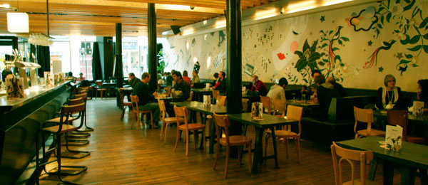
Which tables should waiter book for this company of friends?

Slide 6
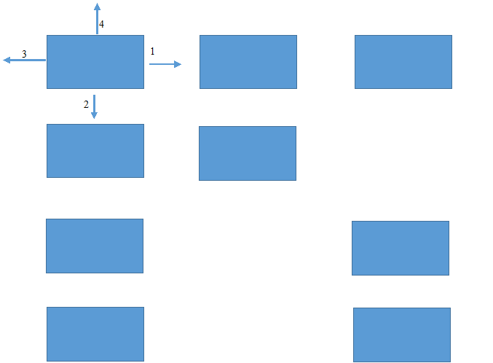
The way of searching for the tables O(n)

Slide 7
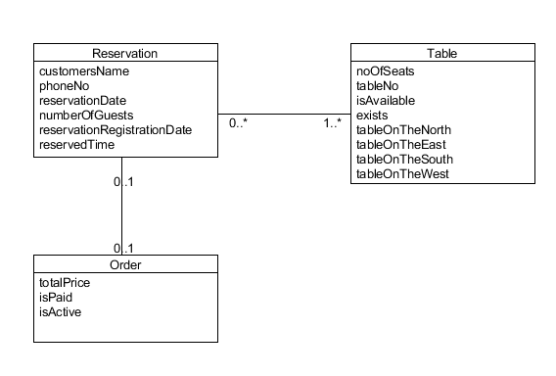
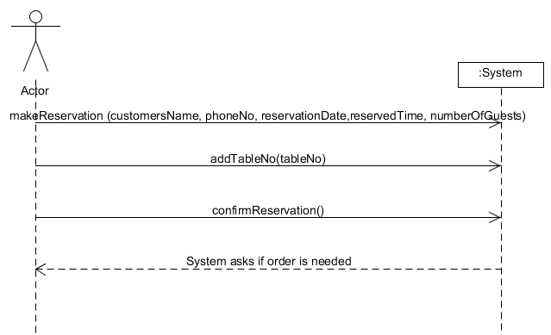
Reservation Use Case
Part Of Domain Model
System Sequence Diagram

Slide 8
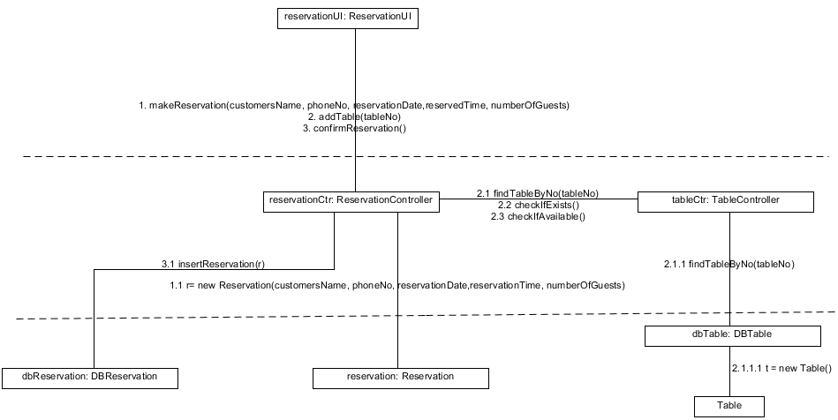
Reservation Use Case
Interaction Diagram

Slide 9
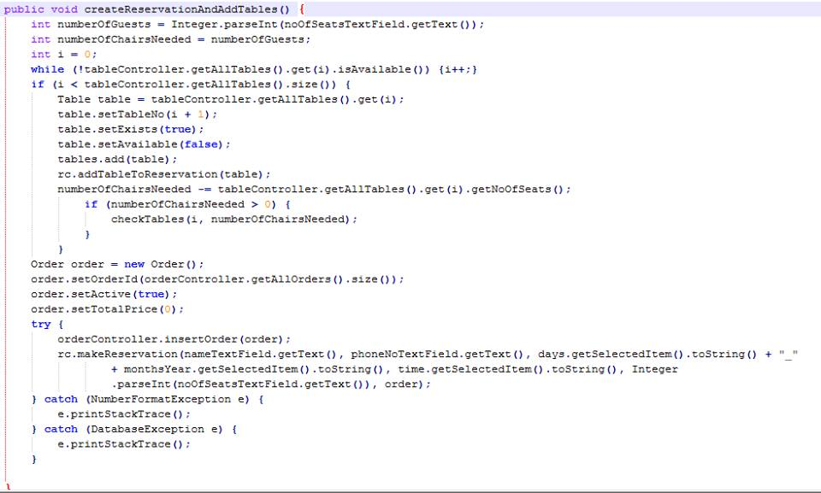
Reservation Use Case
Code part 1

Slide 10
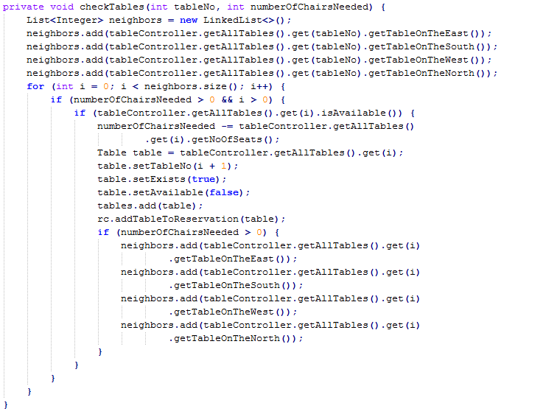
Reservation Use Case
Code part 2

Slide 11
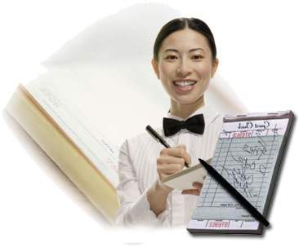
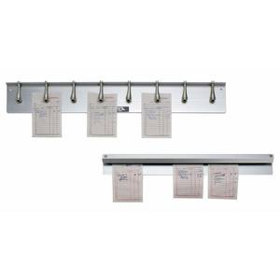
What About The Orders?

Slide 12
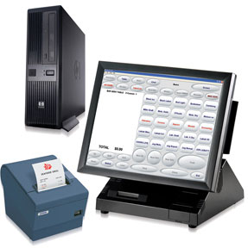

Lets Digitalize this!

Slide 13
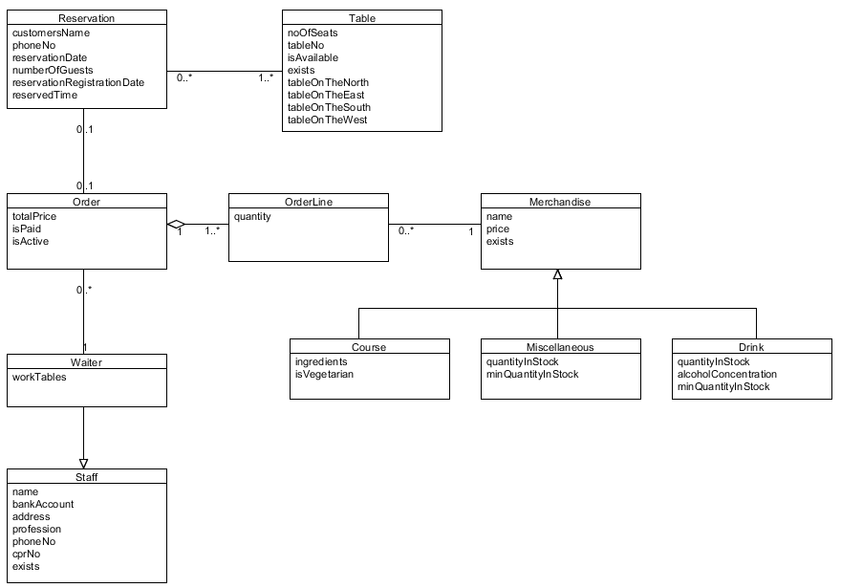
Make Order Use Case
Domain Model

Slide 14
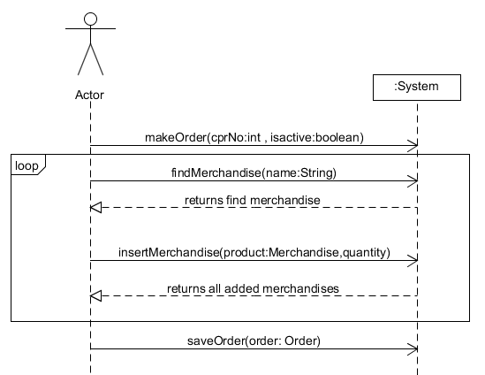
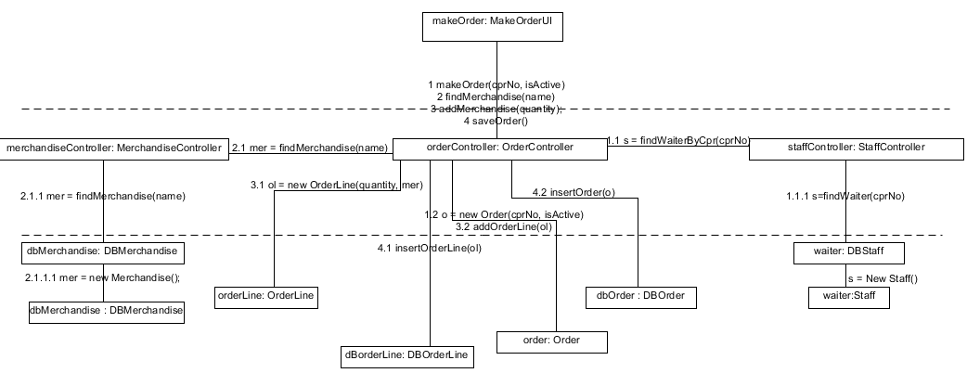
Make Order Use Case
System Sequence Diagram
Interaction Diagram

